Slide 1
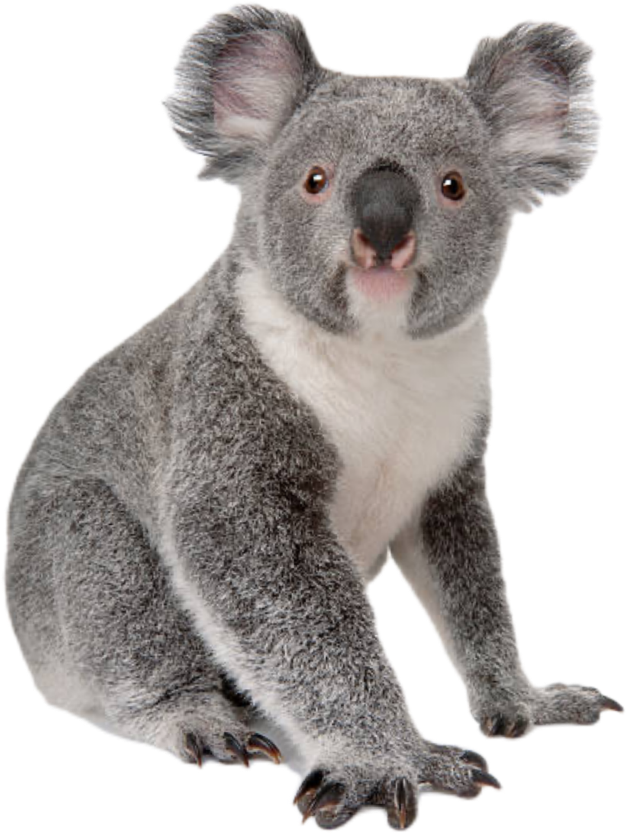
KOALA
Hi ~
Student name: Felicity
Student ID:HPCX73615
Class: 1.2

Slide 2
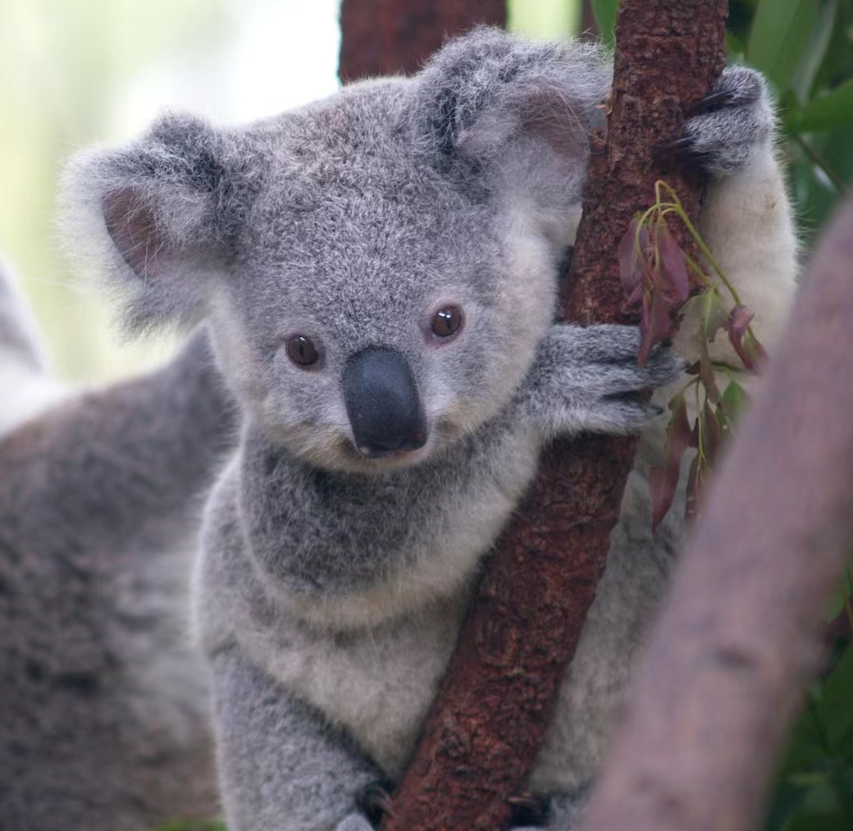
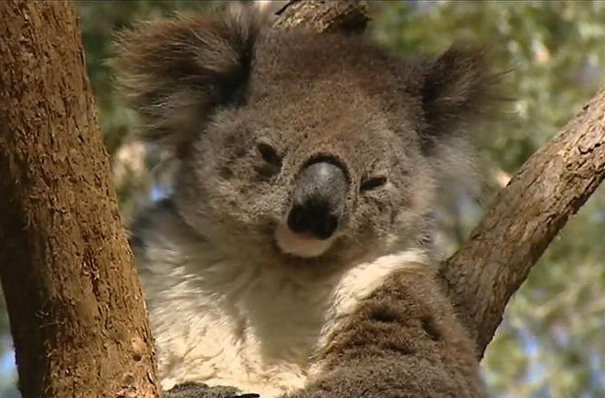
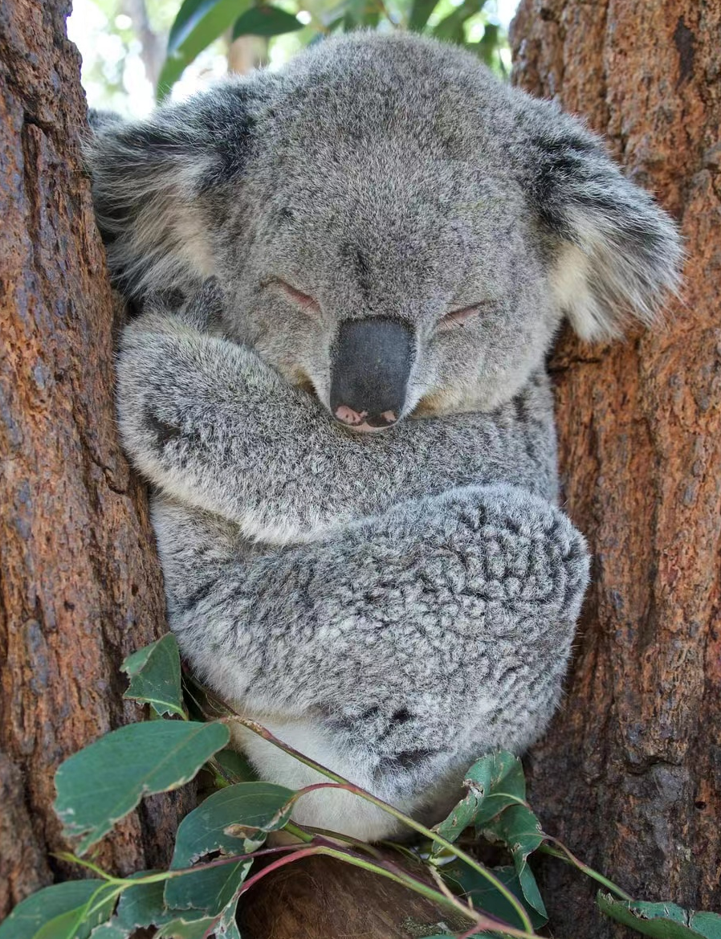
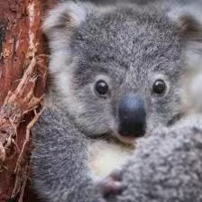
What does Koala looks like?

Slide 3
KOALA
Physical properties
Size: about 60 to 85cm
Weight: 14kg
Markings: virtually tailless, stout and gray with a pale yellow or cream-coloured chest. Small yellow eyes and big fluffy ears

Slide 4
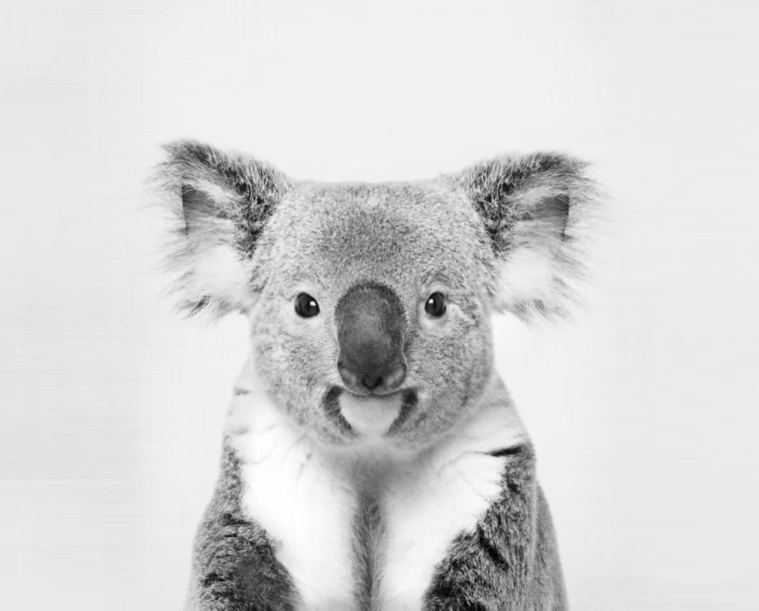


Slide 5
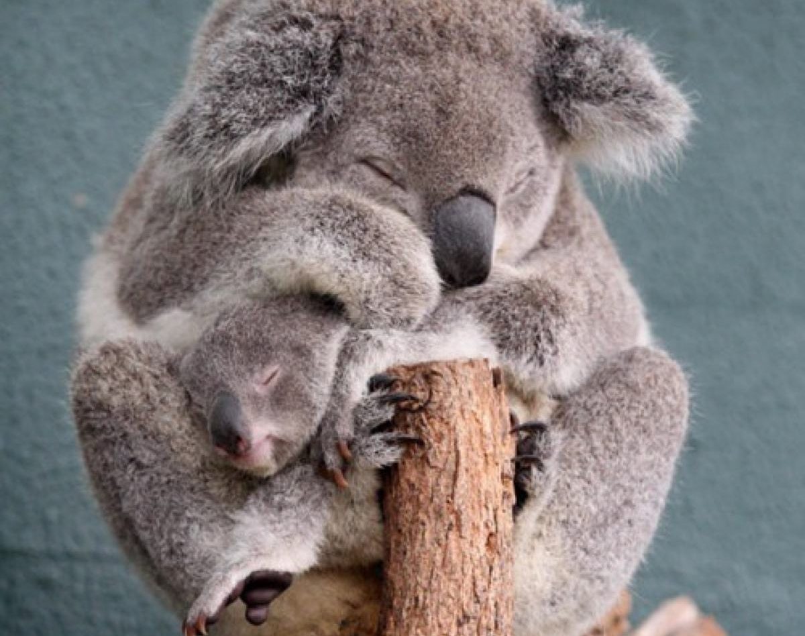
Why Koala is endangered?
habitat destruction
domestic dog attacks
bushfires and road accidents

Slide 6

References
The Editors of Encyclopedia Britannica. “Koala.” Encyclopœdia Britannica, Encyclopædia Britannica, Inc., 6 May 2022, https://www.britannica.com/animal/koala
picture. “Koala.” Google, Google, 20 Aug. 2022, https://www.google.com/search?q=koala&rlz=1CDGOYI_enUS975SG975&hl=zhCN&prmd=imvn&source=lnms&tbm=isch&sa=X&ved=2ahUKEwjVtsbCkIn4AhVfnI4IHQHkBpYQ_AUoAXoECAIQAQ&biw=390&bih=669&dpr=3#imgrc=w2ucNkqt_AHo8M.
“Panda.” Wikipedia, Wikimedia Foundation, 21 May 2022, https://zh.m.wikipedia.org/zhtw/%E5%A4%A7%E7%86%8A%E7%8C%AB.

